Slide 1

Weekly Presentation
Team 2: Emily, Feruza, Dunya
Readings
Drucker 2021, Ch.2: modeling, tokenization, parameterization, cleaning, ethics
Gitelman 2013: no “raw” data, be transparent
Havens et al. 2024, MELP: crowdsourcing, TEI, IDs, authority links (Team 2)

Slide 2
Table of Contents
summary of the reading
MELF workflow
the relevance between the week’s topic and this article
significant contribution
connection
critique
comparison
reflection
questions for class

Slide 3
Short Summary
The Maria Edgeworth Letters Project (MELP)
transform Maria Edgeworth's physical letters into a searchable, digital database.
"as-is" approach: preserving the original form of the letters
operates in three main stages: archiving, transcription, and encoding
use TEI schema and XML format, and using Zooniverse platform to invite volunteers into transcription stage

Slide 4
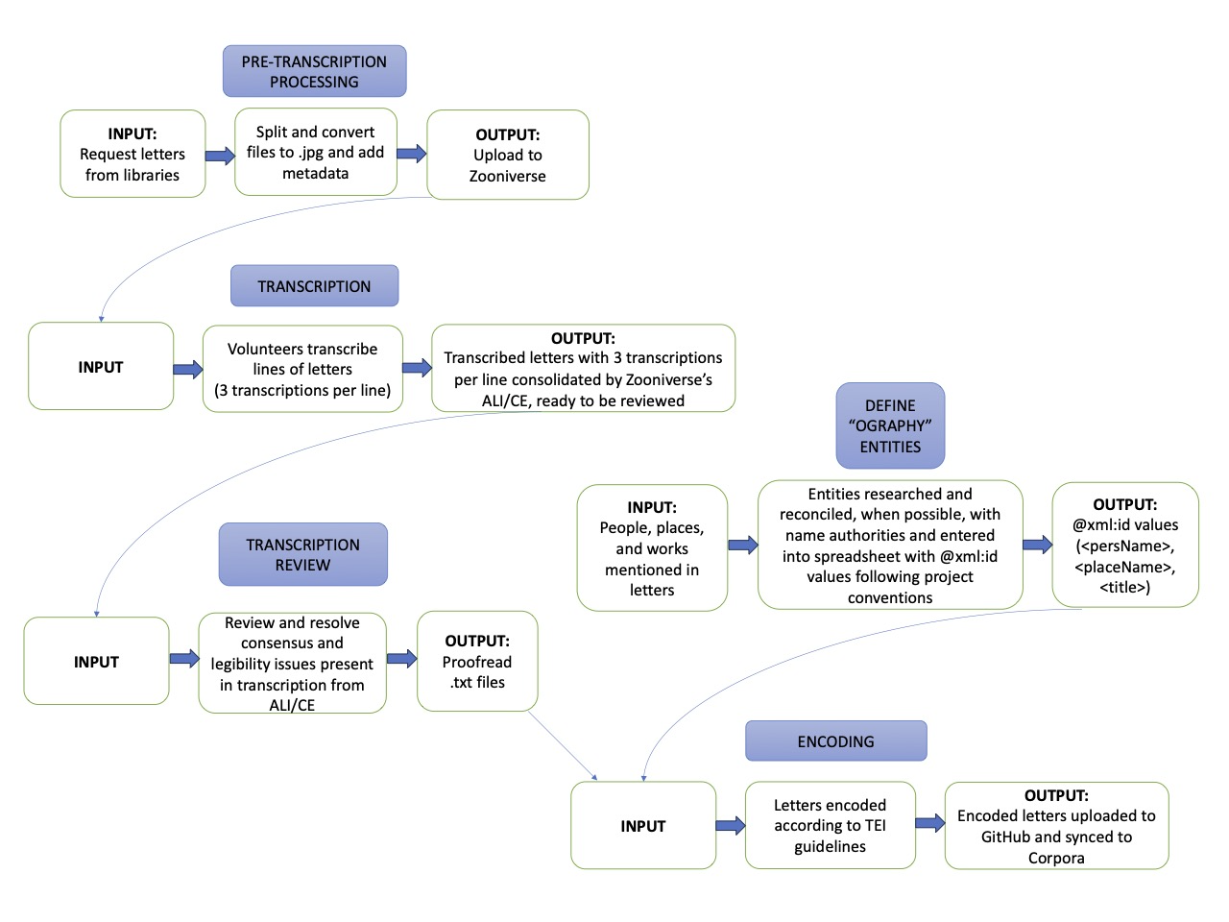

Slide 5
Short Summary
transcription
volunteers transcribe letters
researchers choose the most statistically common choice
"the wisdom of crowds"
encoding
created “ography” files that are linked to external, open databases
apply the TEI tags to the letter text using the “ography” file information

Slide 6
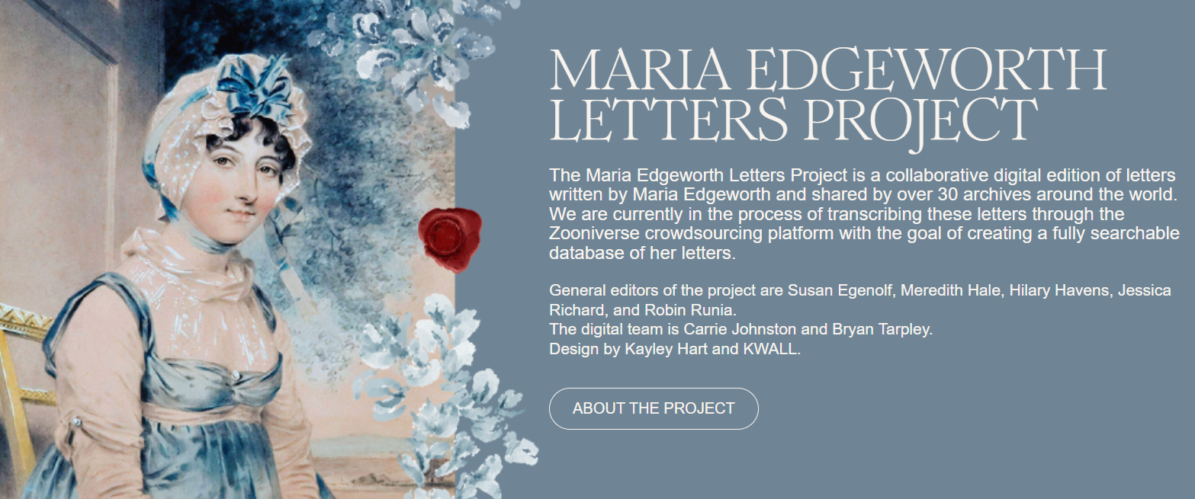
Not just creating a digital archive, they are trying to establish a new model for ethical, open, and highly collaborative digital humanities research.

Slide 7
The relevance between this week’s topic and this article
Data creation
unstructured handwritten letters
-> structured digital data
Data Curation
create tutorial
select the most statistically common choice
upload the result online
use digital tools
link to external and open databases
align with other institution in coding in some way (ex.delete “gender”)
Digital Archives

Slide 8
What MELP contributes to Digital Humanities (DH)
Digital Humanities
Inclusive & Reliable Workflow
Future-proof files
Crowdsourced transcription with staff reconciliation and editor checks
Plain text/XML core; data exportable for long-term use (not locked into one system)
Entity IDs + “address books”
Structured & Reusable Texts
Stable IDs for People/Places/Works; variants recorded, not erased (no name loss)
Linked data out
Letters tagged (people/places/dates, page/line breaks) -> machine-readable and human-faithful
VIAF (people), GeoNames (places), Wikidata (works) -> cross-project reuse

Slide 9
What the other readings contribute
“Raw Data” Is an Oxymoron (Gitelman)
The DH Coursebook, Ch 2 (Drucker)
Thesis: Data is made through choices and contexts (no “raw” data)
Field manual: How to model humanities data
Methods: Tokenization, parameterization, cleaning docs
Impact: forces transparency of selection, modeling and “cleaning”; critiques myths of objectivity
Standards: Unique IDs, vocabularies, data formats, ethics & privacy checklists

Slide 10
Topics of concern
Available solutions
Ethics & Privacy
Consent, provenance, careful reuse
Labor & Credit
Acknowledge authors
Standards vs specificity
Shared IDs without cultural erasure
Sustainability
Durable formats, maintenance plans

Slide 11
Critique & Practical Mitigations
Risks:
Varying speed/accuracy
Tagging needs training
Funding-dependent
Maintenance-dependent
Strengths:
Transparent pipeline
Durable core
Linked-data friendly
Critique & Practical Mitigations
Method fit:
Natural match with letters
Scalable crowdsourcing
Evolvable schema and spellings
Mitigations:
Hand-written text recognition
Templates + short trainings
Recurring maintenance
Automated checks

Slide 12
Comparison of the Readings
Comparing the readings
Drucker (2021) provides practical questions
Compare data models from MELP and the VOC-Opvarenden enhancement project
Similarities & Differences
Digitizing historical artifacts:
→ Edgeworth: 1768-1859,
→ muster records: 1633-1794
Struggles in completeness:
→ MELP > VOC
Transparency:
→ MELP > VOC
Notes:
Comparing the readings with each other
Drucker (2021) provides practical questions
Compare data models from MELP and the VOC-Opvarenden enhancement project
Similarities & Differences
Digitizing historical artefacts:
Edgeworth: 1768-1859, muster records: 1633-1794
Struggles in completeness:
MELP > VOC
Transparency:
MELP > VOC

Slide 13
Reflection of the implications
Implications for future research
MELP and its humanistic approach to outsourced labor
Developing countries & ethically questionable working condintions
Gamechanger for modern day research methods?
Drucker’s checklists for personal use
New understandings of the VOC-Opvarenden project
The completeness of MELP in the three components of digital humanities
→ (materials, processing and presentation)
More insight in limitations VOC:
    Type ll errors
More attention needed for the VOC as a black page in history
Notes:
Implications for future research
MELP and its humanistic approach to outsourced labor
Developing countries & ethically questionable working condintions
Gamechanger for modern day research methods?
Drucker’s checklists for personal use
New understandings of the VOC-Opvarenden enhancement project
The completeness of MELP in the three components of digital humanities
(materials, processing and presentation)
More insight in limitations VOC:
Type ll errors
More attention needed for the VOC as a black page in history

Slide 14
MELP
Tokenization
“Is the essay on the MELP project too good to be true?”
(Un)Structured
If ‘Washington’ might be a person or a place, how would you tag it in MELP when you’re unsure?
In Drucker’s terms, what did MELP actually structure and what did they leave unstructured on purpose? Does that feel like the right mix?
Questions
Sustainability
Clean vs Messy
If funding stopped next year, which three things do we have to keep so the dataset still works, TEI/XML export, data dictionary, cleaning log, DOIs, code, or something else?
Where do you draw the line between cleaning and keeping the mess (weird spellings, cross-outs)? Pick one: names / dates / places.
History
How is the VOC’s violent past considered to keep the project fair and balanced?

Slide 15
References
Drucker, Johanna. The Digital Humanities Coursebook: An Introduction to Digital Methods for Research and
Scholarship. Routledge, 2021. https://vu.on.worldcat.org/oclc/1236262568
Gitelman L (ed) (2013) "Raw data" is an oxymoron. Infrastructures series, The MIT Press, Cambridge, Massachusetts ; London, England Raw Data Is an Oxymoron by Lisa Gitelman (z-lib.org).pdf
Havens, Hilary, Eliza Alexander Wilcox, Meredith L. Hale, and Jamie Kramer. ‘From Archive to Database:
Using Crowdsourcing, TEI, and Collaborative Labor to Construct the Maria Edgeworth Letters Project’. Digital Humanities Quarterly 18,
no. 2 (2024). https://digitalhumanities.org/dhq/vol/18/2/000424/000424.html
OpenAI. (2023). ChatGPT (13 Feb. versie) [Large language model]. chat.openai.com/chat
Petram, L., Koolen, M., Wevers, M., & Van Lottum, J. (2024). Charting Lives and Careers: Enriched Data About the Dutch East India Company’s Eighteenth-Century European Workforce. Journal Of Open Humanities Data, 10. https://doi.org/10.5334/johd.210

